Slide 1

Why ‘Good Friday’?
If this is a reminder of the day Jesus died, why do Christians call it ‘Good Friday’?

Slide 2
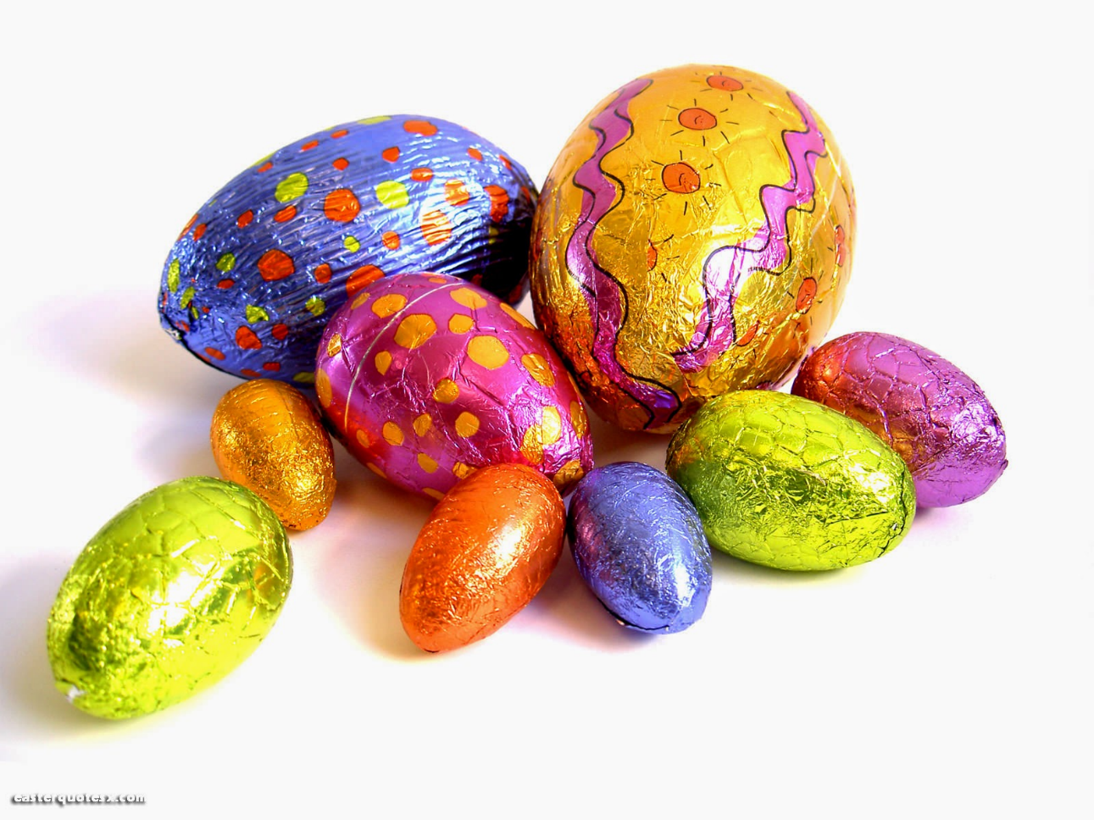
More than chocolate?

Slide 3
Why ‘Good Friday’?
Jesus might be the most famous person on earth. Over 2.4 billion people call themselves Christians today. That is a lot of followers!
The day he was killed might look like a sad day, a very tragic occasion. Being crucified by the Romans was a dreadful way to die.
But the Christians call the day of Jesus death ‘Good Friday’
Why do they do that?
The answers might be found in the four books of the Bible by Matthew, Mark, Luke and John, the four Gospels. In this session, you will have to think for yourself about the question, Why ‘Good Friday’?
To help answer the question, we will look at some works of art by pupils. Can you select a favourite?

Slide 4
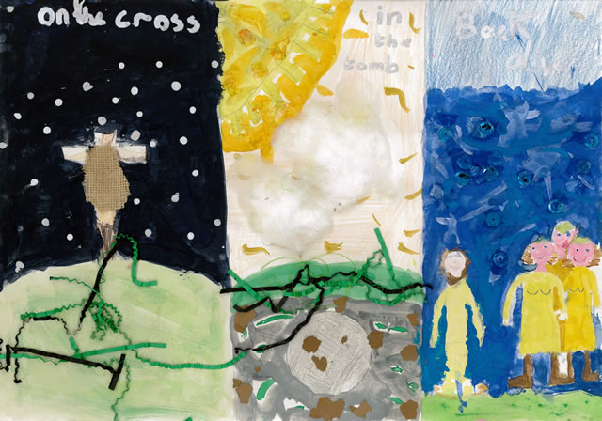
The Stages of Jesus' Life!
Alex & Jack, Aged 8-9
“Our picture represents the stages at the end of Jesus' life. The three stages are on the cross, in the tomb and back alive.
On the cross represents when he got nailed to a cross, in the tomb represents when Jesus got laid in a tomb and back alive represents when he rose from the dead.
The whole turning point of Christianity was when he came alive from the dead.”

Slide 5
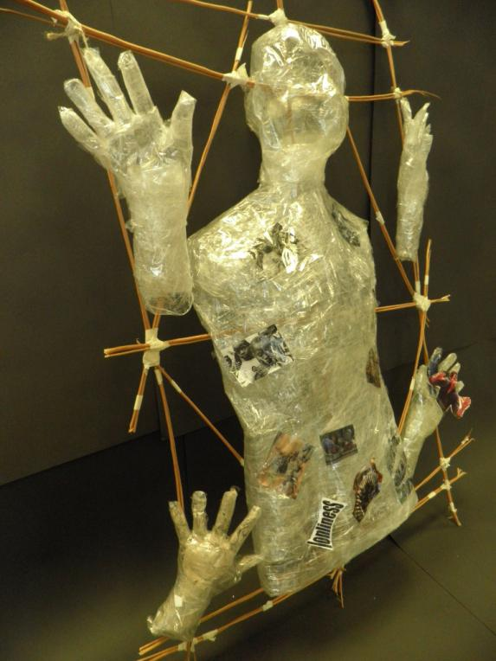
Tom, Billy and Joe are 13
“God: Why?”
When he was crucified on Good Friday Jesus asked: ‘My God, why have you forsaken me?’ A terrible moment. Our piece shows the idea of people drowning into the earth, leaving life as they used to know it. It shows hands and faces reaching towards what they hope will bring help, to save them from the hatred of others and the terrible images that crawl in their minds.
We were trying to represent all the pain and suffering of Jesus and of all humanity. The hands are reaching out, trying to locate God, but is he out of reach? It is a bit like a crucifixion. Jesus felt this pain. He felt abandoned.”

Slide 6
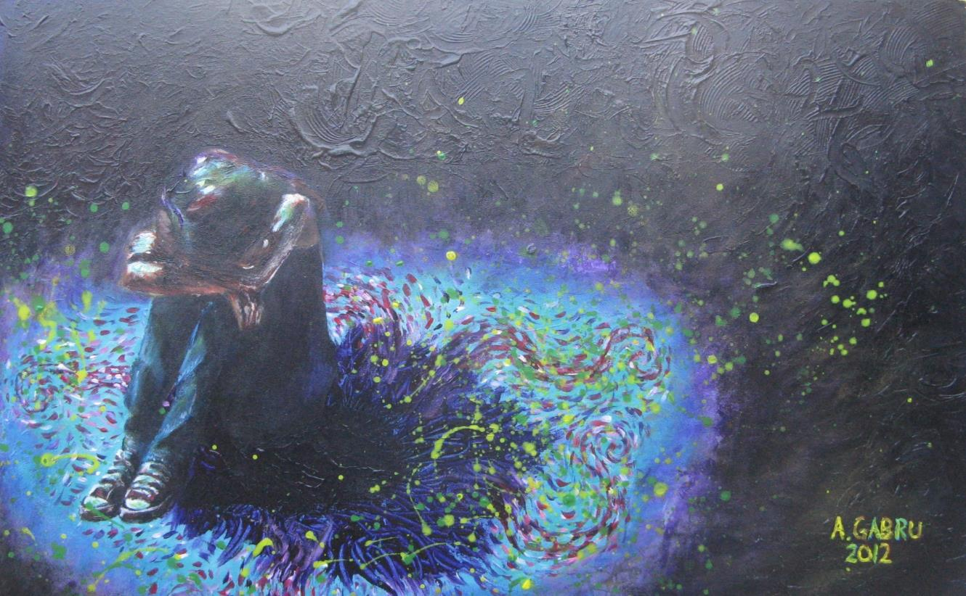
Amy created this picture. She says:
“I wanted to show what loneliness looks like. I think the story of Jesus dying on the cross must have been incredibly lonely. Humans today also experience the feeling of being alone. But the girl in my painting needs to look up, because the swirls of love are all around her. Good Friday is good because of Easter Sunday.”

Slide 7
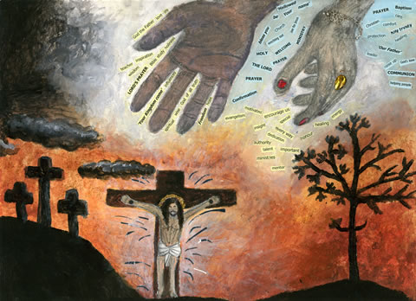
The Personality of God, Anastasia (13)
“The three crosses show how I interpret Jesus: I used glitter glue for the crown, to show that he is a king. White paint symbolizes that he is pure and perfect. The tree in the bottom right of the painting represents that with God you grow: the side facing him has leaves, the other side is bare and empty.
Dark clouds signify problems in our lives. We don't know what God looks like, but I think we know his personality. I think God is loving, welcoming, approachable and quick to forgive, as Jesus said when he died: ‘Father forgive them.’
The usual stereotypical view of God is an old white man. I have shown God's hands, one like a woman's, one black. God tries to show us who he is, through the Bible and our own religious experiences. The words around the hands of God remind me what I believe he is like.”

Slide 8
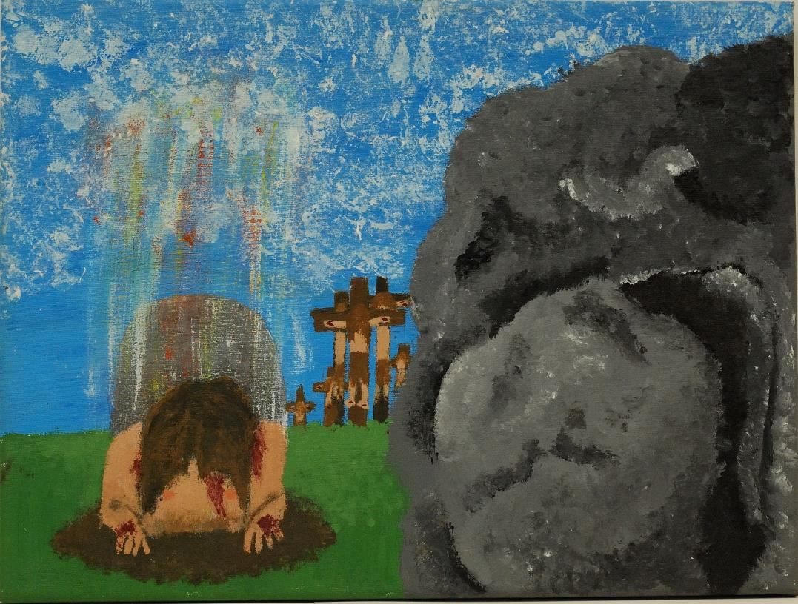
The Cross – Beginnings and Endings, Amy, 14
“My painting shows men in the background of hung upon crosses. Jesus – and many others – were tortured and hung upon a cross. I’ve painted a cave with a boulder for a door, the boulder is ajar showing the dark inside of the cave. This is the place where Jesus was taken after he was crucified; this represents the world and the violence we live in today. To the left of it, it shows Jesus rising from a grave. The resurrecting Jesus has his head hung: humans often waste life. Jesus himself was killed for virtually no reason. I am thinking of all the violence and suffering that humans bring upon each other.
There are crepuscular rays shining down on Jesus from the heaven. This shows that God is in control of life and death. What looked like the end of Jesus’ life was actually a second chance for us all and a new beginning.”

Slide 9
Five ideas from young people
You have seen five artistic ideas about the meaning of ‘Good Friday’ made by young people aged 8-15.
Which one did you think was best?
You will have a couple of minutes to talk about these ideas, and then to say which one meant the most to you.
All our knowledge about Jesus’s death comes from the Gospels, which are a part of the New Testament.
In today’s assembly, you will be offered a copy of the New Testament (and Psalms) for yourself. Please do take it and read it. A free gift.
You can think for yourself about the meaning of Jesus’ last days, and the empty grave he left behind.

Slide 10


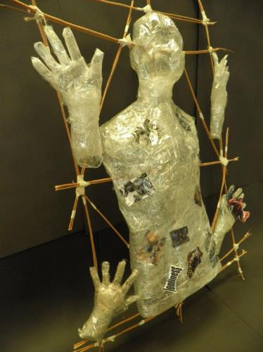


Different ideas about the day called ‘Good Friday’. Which one did you think was the best?

Slide 11

In the Bible…
In the Bible, you will find four versions of the whole story of Jesus’ last days and Easter.
Saint Paul explains the story of the crucifixion like this: ‘God shows his love for us in that while we were still sinners Christ died for us.’ (Romans 5)
Members of the GOOD NEWS For Everyone!, who are giving away free copies of the New Testament at your school today, believe that ‘Good Friday’ is good because it was the day Jesus showed God’s love on the cross.
Happy Easter!

